Slide 1

EESTEC Hackathon
Radar Based Vital Sensing
Team 4 Abhishek Ganesh
Akashdeep Roy
Sanjeev Kumar

Slide 2
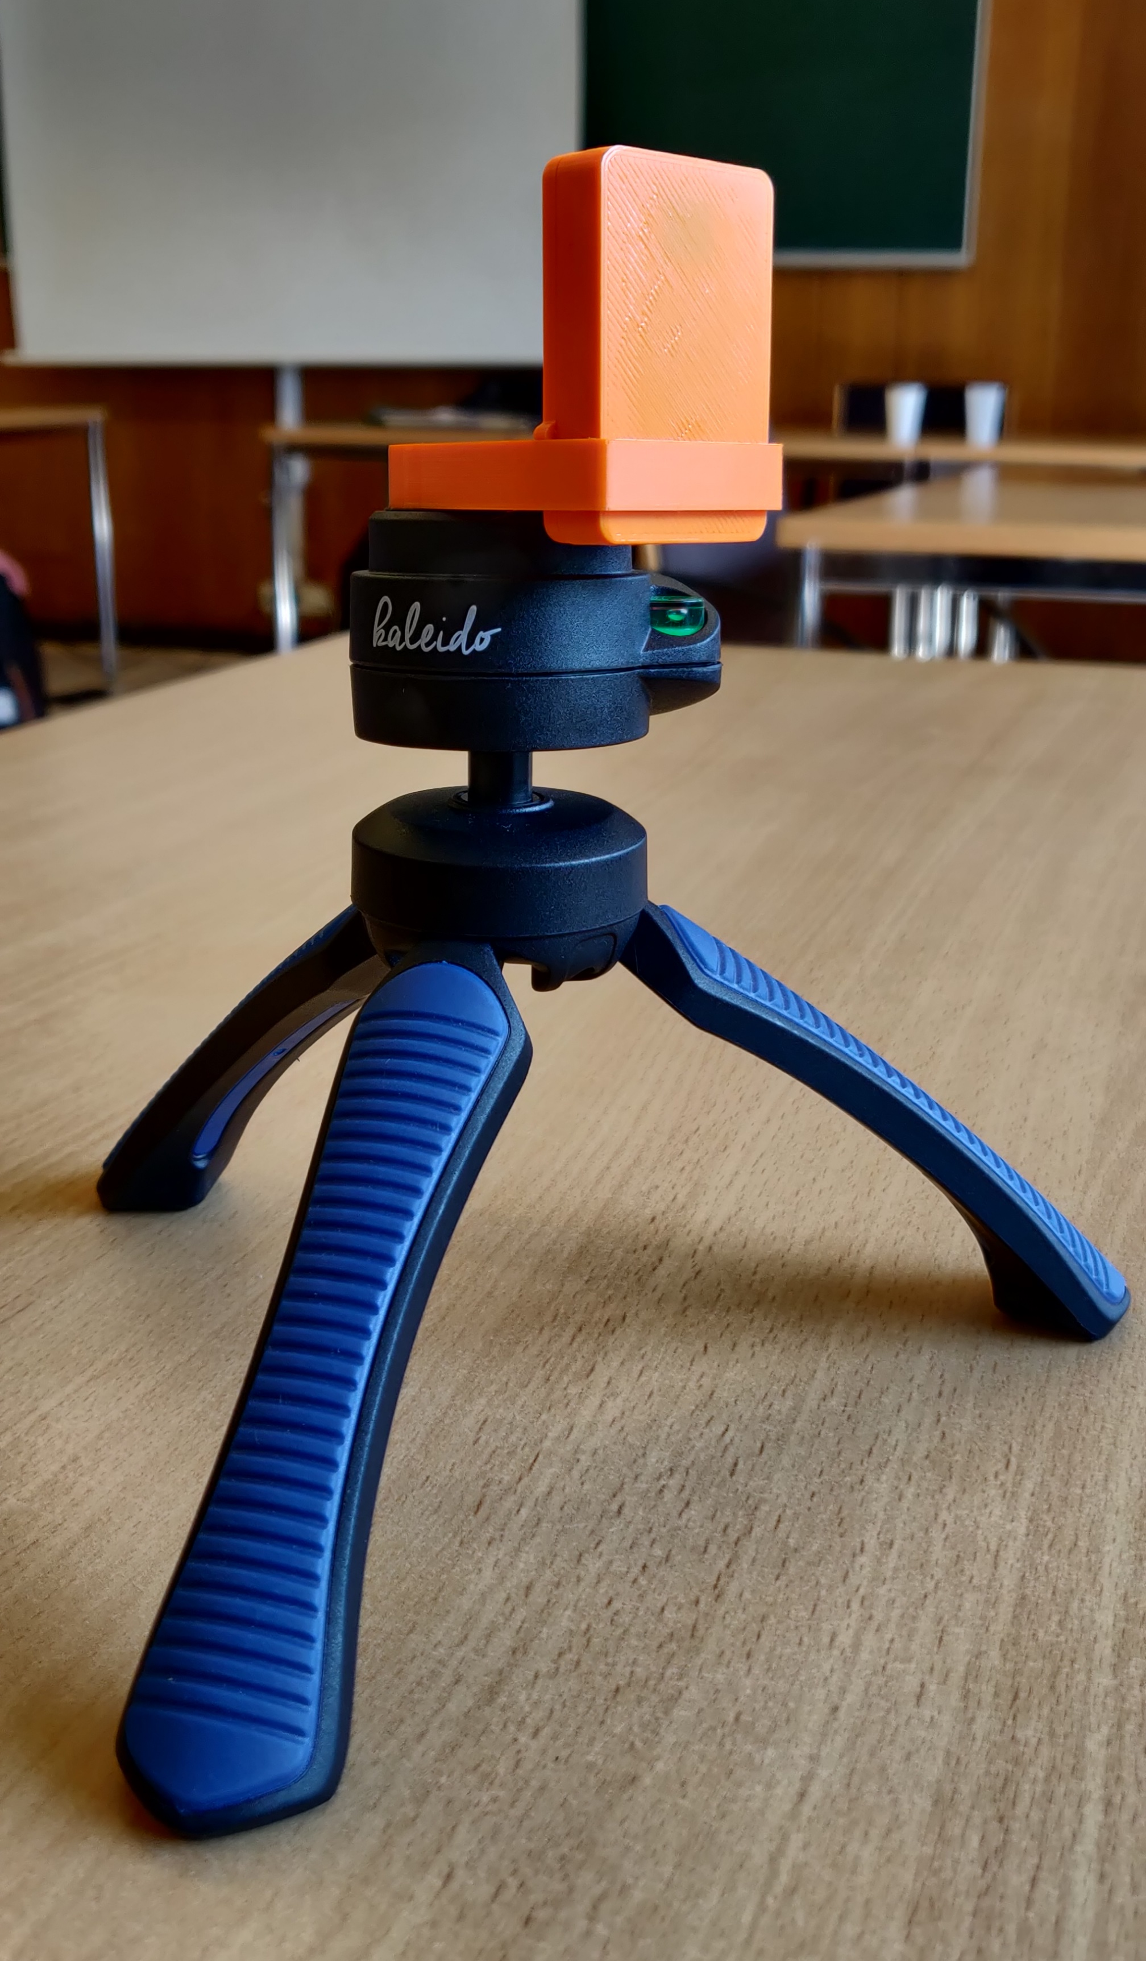
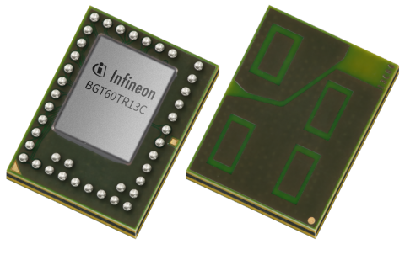
Infineon‘s BGT60TR13C Radar Chip
XENSIV™ 60GHz radar sensor for advanced sensing
Presence detection/segmentation
Touchless interaction
Vital sensing

Slide 3
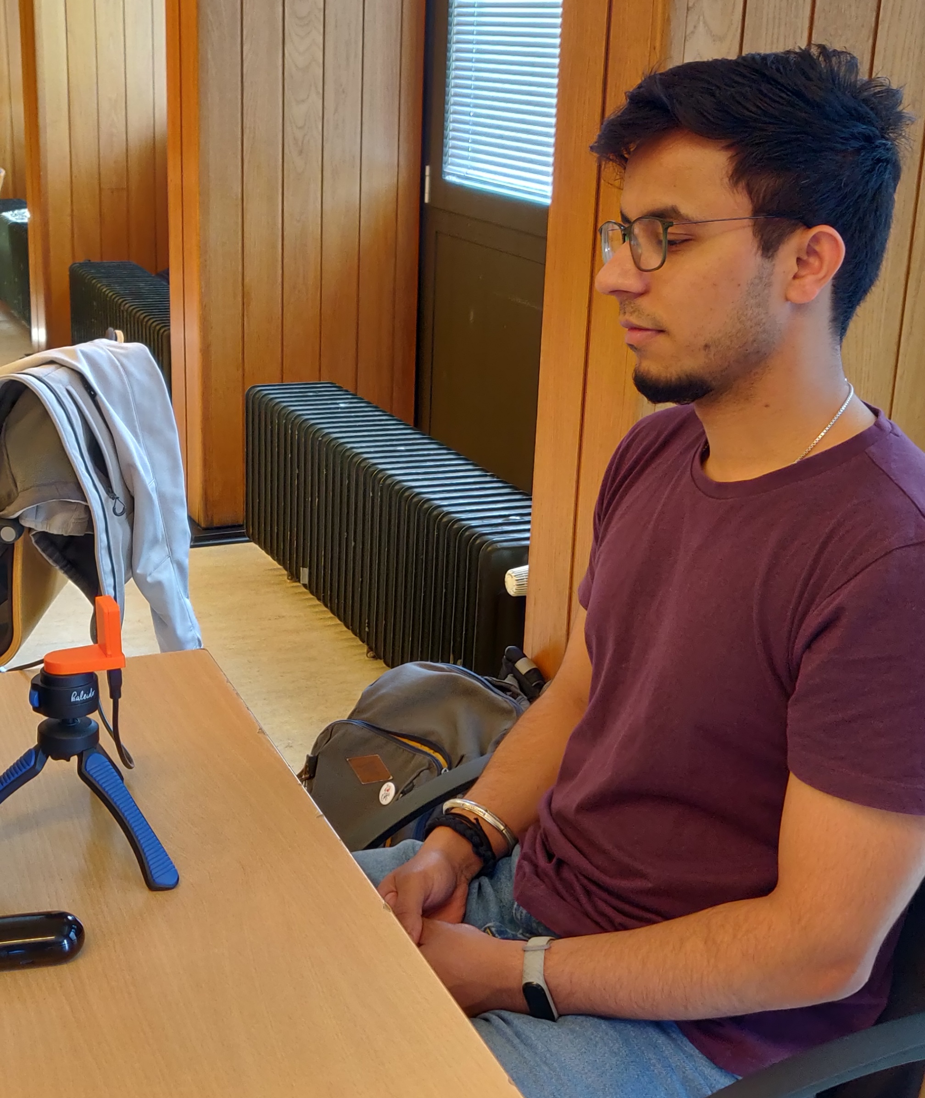
Target Scenario
A single person sitting in front of the radar (facing towards the chest) ~1m

Slide 4
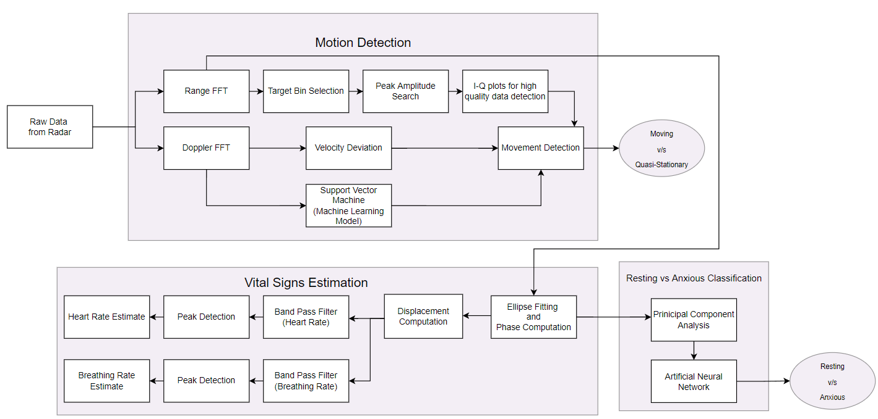
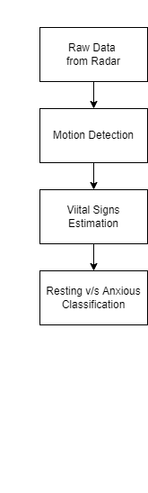
Algorithm

Slide 5
Data Collection for Machine Learning
Support Vector Machines (Movement v/s Quasi-Static Classification)
Artificial Neural Network (Resting v/s Anxious State Classification)
Data Specifications:
Data: Range_FFT Data
Classes: 2 (Movement, Quasi-Static)
No. of Training Samples: 120 per class
Data Specifications:
Data: Phase Data
Classes: 2 (Resting, Anxious)
No. of Training Samples: 180 per class

Slide 6
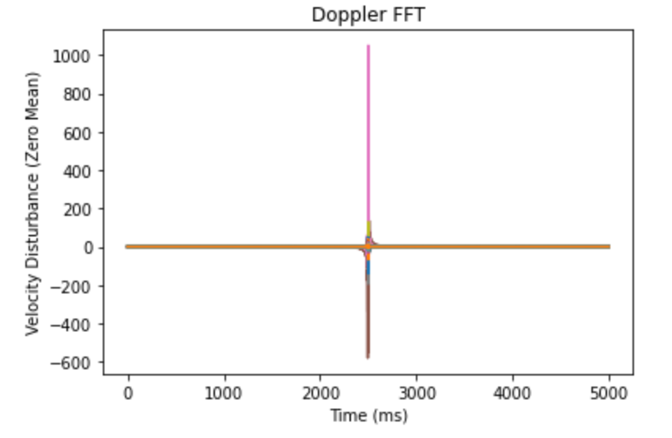
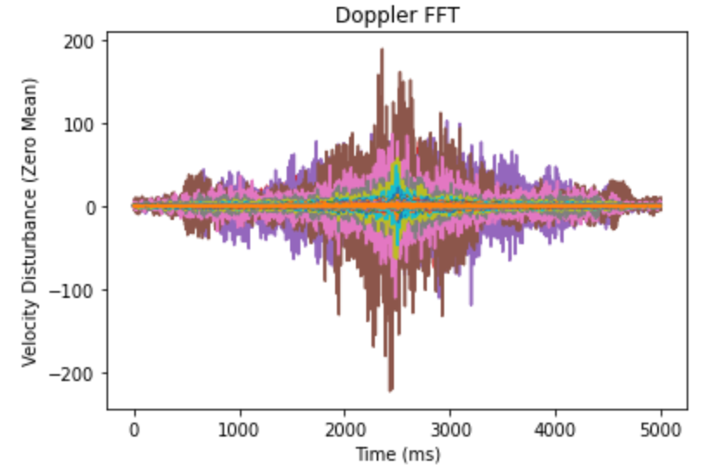
Moving and Quasi-Static State Classification
Velocity Deviation (Quasi-Static)
Velocity Deviation (Moving)

Slide 7
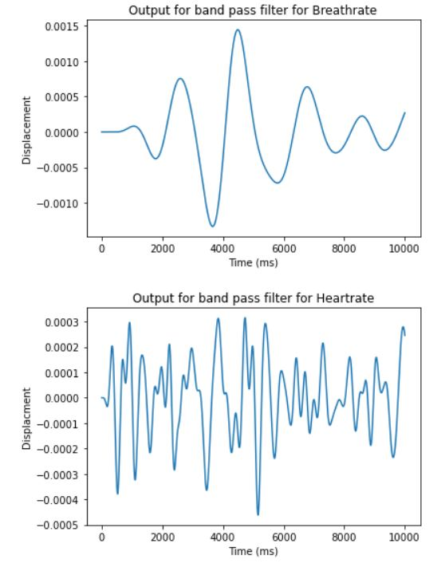
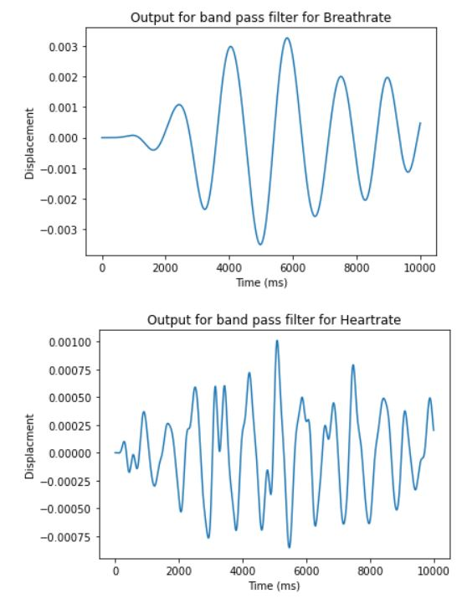
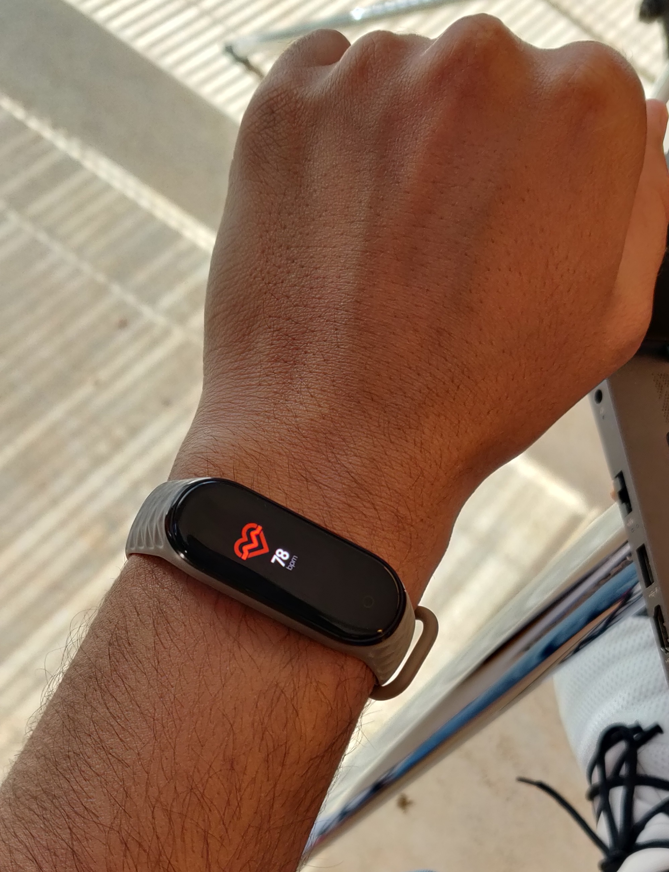
Resting and Anxious State Classification
Heart Rate and Breathing Rate (Resting)
Heart Rate and Breathing Rate (Anxious)

Slide 8
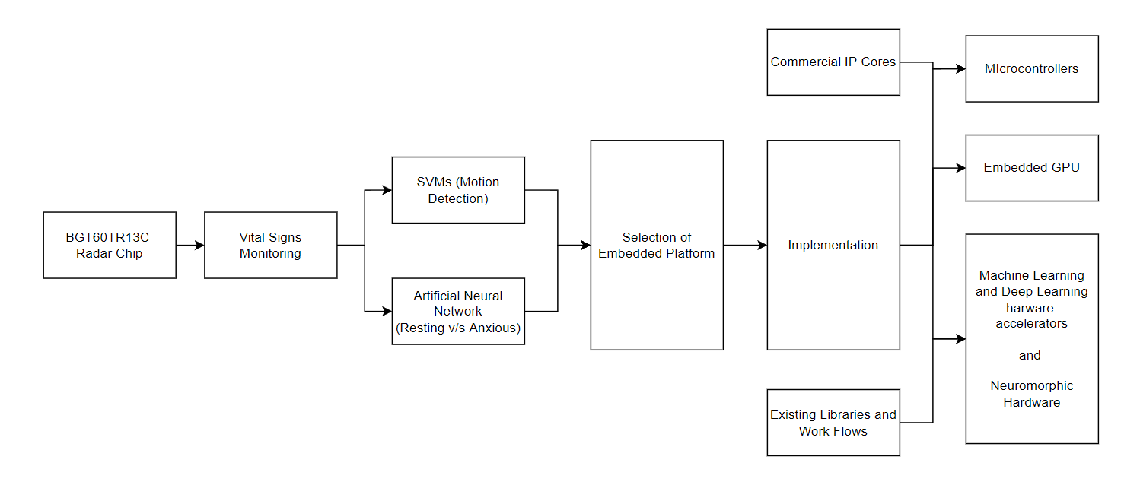
Hardware Implementation (Embedded Perspective)

Slide 9
Hardware Implementation (Embedded Perspective)
Load Reduction
Principal Component Selection
Quantization
Conversion of skLearn models into C header files
micromlgen — SVM, SVC, PCA (github project)
Microsoft ELL — Neural Network (github project)
Tensorflow Lite
TinyML
Memory Management and Segmentation
Language
C/C++
Rust
MicroPython
Embedded Learning
Inference code generation
FLASH programming
Digital Filters Implementation
Interrupt handling

Slide 10
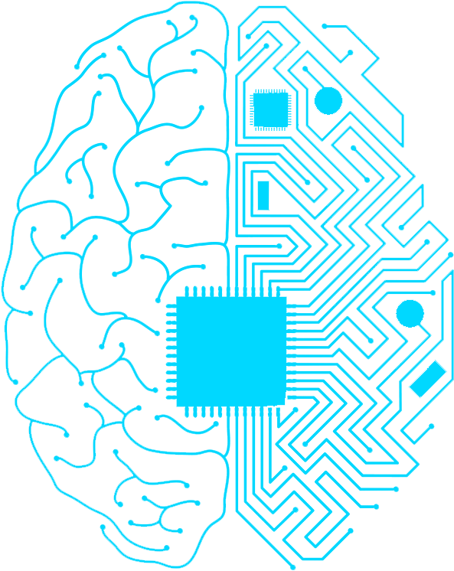

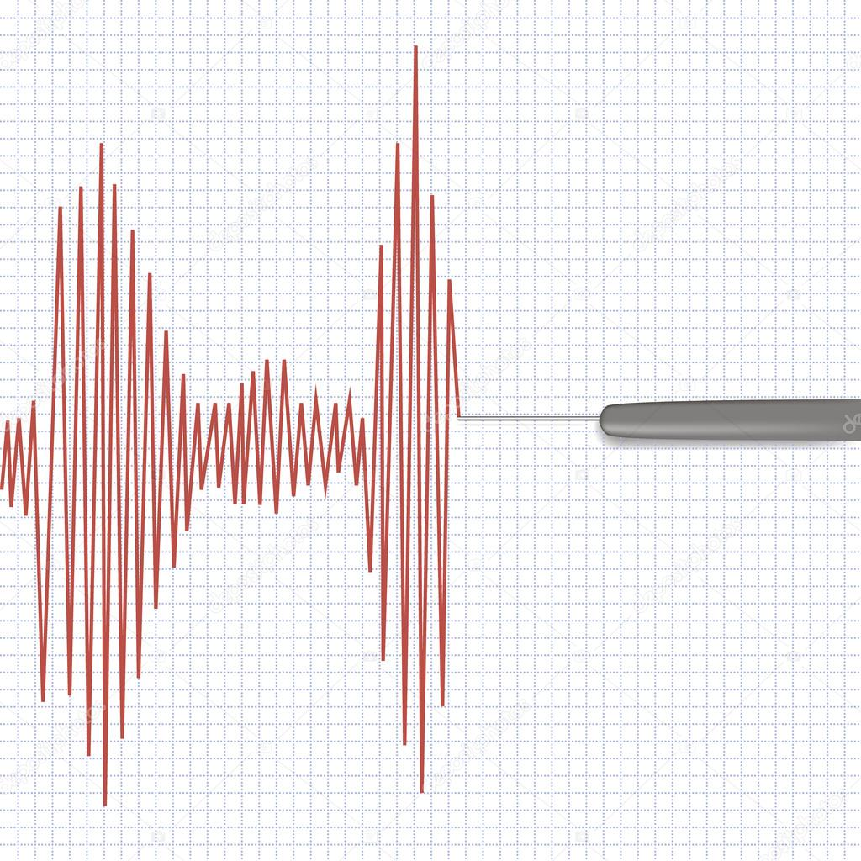

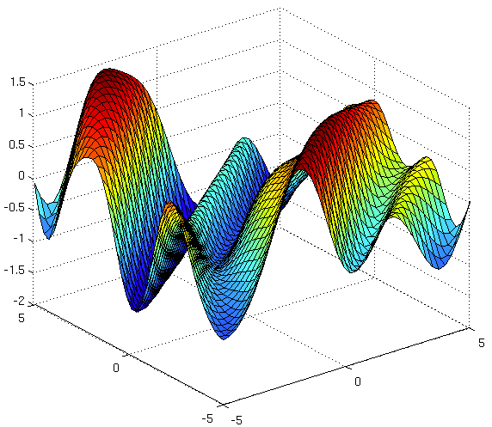
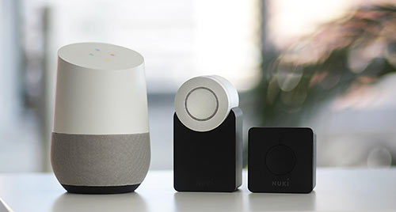
Future Scope and Possible Approaches
Drowsiness detection in vehicle drivers
Non-Contact Lie detectors
Better Machine Learning Models for Accurate Predictions
Information Fusion for Better Estimates
Connected Home IOT Devices
Probabilistic Output for Vital Sign Measurements

